Slide 1
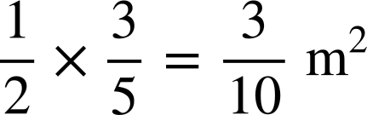
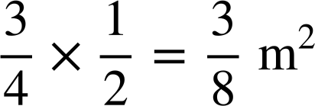
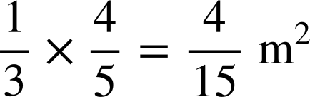
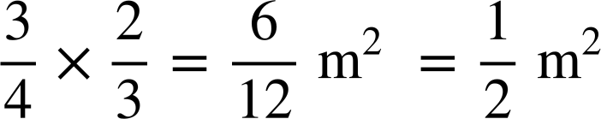
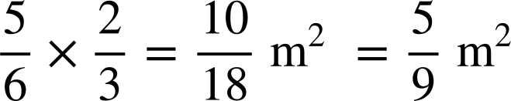
Checking understanding of multiplication with fractions
Task A: Exploring the area model
1) Each of the large squares have an area of 1 m². For each square:
a) Label the dimensions of the shaded rectangle
b) Write the calculation represented by the area of the shaded rectangle.
c) Work out the area of the square that is shaded.

Slide 2
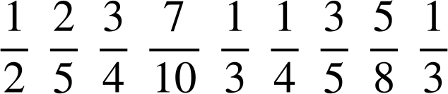
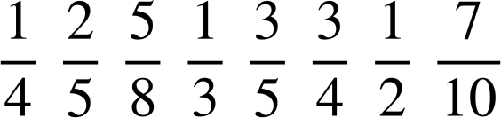
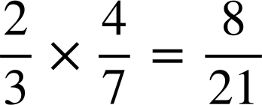
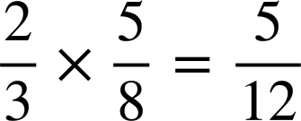
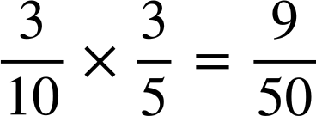
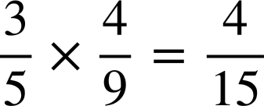
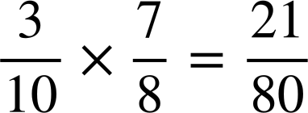
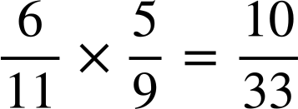
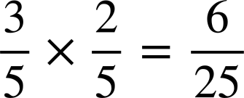
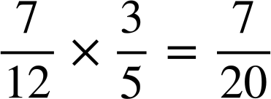
Checking understanding of multiplication with fractions
Task B: Multiplication of fractions
1) Calculate the answers to the following. Simplify all answers. Find them in the table and write down which letter each gives. Rearrange your letters to make a word.
A | B | C | D | E | F | G | H | I | J | K | L | M
N | O | P | Q | R | S | T | U | V | W | X | Y | Z
a)
b)
A
c)
d)
U
e)
f)
O
g)
h)
R
i)
T
R
M
N
E
The word is NUMERATOR
2) What are the missing digits in the following calculations?
a)
b)
c)
d)
e)
f)
g)
h)
Mathematics in Education and Industry
v2.2

